Slide 1
Retail Sales Analysis
By Sonam Somarajan

Slide 2
Objectives
Analyze sales performance
Understand customer behavior
Identify product/category trends
Provide business recommendations

Slide 3
Dataset Overview
Number of records: 1000
Key fields: Gender, age, product category, quantity, total amount
Tool used: Excel, Word, PPT

Slide 4
Business KPIs
Total Revenue: 4,56,000
Average Order Value: 456
Total Quantity: 2514
Customers: 1000

Slide 5
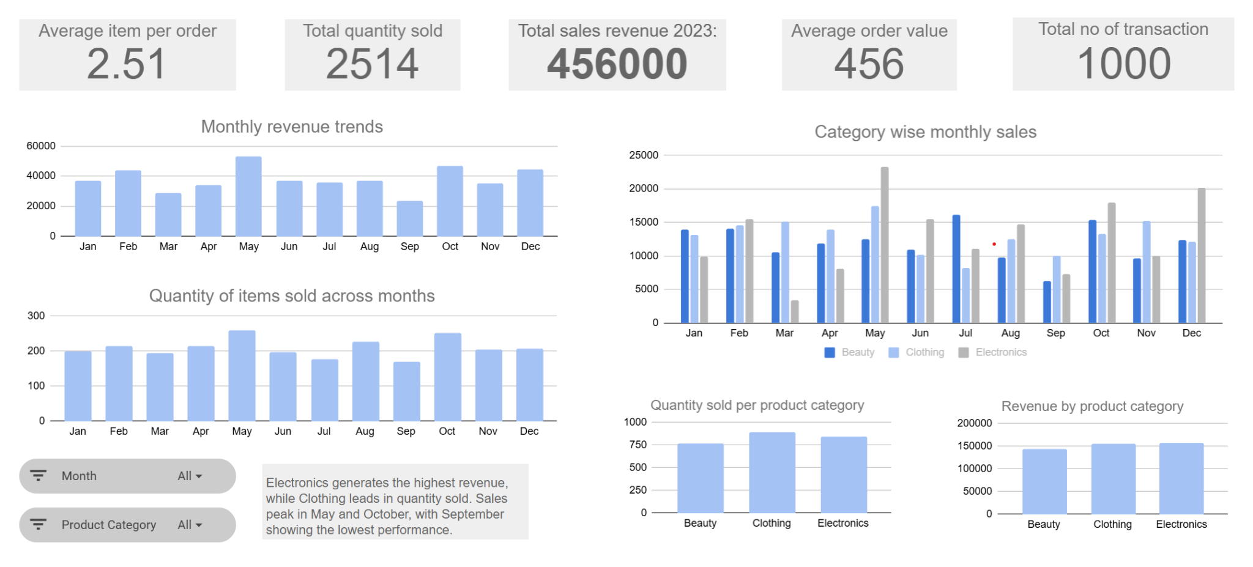
Sales Dashboard

Slide 6
Sales Insights
Electronics was the top revenue category (34.4%), followed closely by Clothing (34.1%) and Beauty (31.5%).
Clothing had the highest quantity sold, showing strong demand, while Electronics earned more revenue due to higher-priced products.
May delivered the strongest overall performance in both revenue and sales volume.
February and December generated high revenue with moderate volume, indicating higher-value purchases.
September recorded the lowest revenue and sales volume, highlighting weaker seasonal demand.

Slide 7
Recommendations based on Sales analysis
Increase promotion of Electronics to maximize revenue while maintaining balanced inventory across all categories.
Use Clothing as a high-demand category to attract customer traffic and drive repeat purchases.
Analyze top-performing months (February, December) to replicate successful sales patterns.
Launch targeted campaigns during low-performing months (September) to improve demand and revenue.

Slide 8
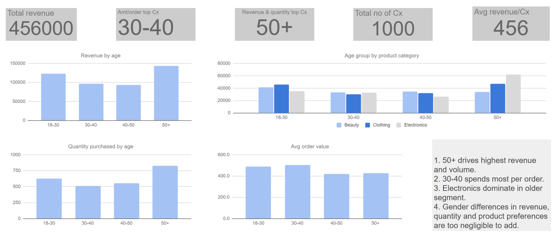
Customer dashboard

Slide 9
Customer insights
Customer base is evenly split by gender, with a slight female majority.
The 50+ age group is the most valuable segment, driving the highest revenue and purchase volume, with strong interest in Electronics.
Customers aged 30–40 have the highest average spend per order, indicating higher-value purchases.
Female customers show slightly higher engagement overall, while males contribute more to Electronics sales.
Younger customers (18–30) contribute steadily and prefer Clothing and Beauty products.

Slide 10
Recommendations based on Cx analysis
Target the 50+ segment with loyalty offers and focused marketing.
Boost repeat purchases from 30–40 customers through incentives and personalized offers.
Match promotions to preferences: Electronics for older customers, Beauty/Clothing for younger segments.
Re-engage the 40–50 segment with discounts and combo deals.
Use cross-selling and upselling to increase order value.
Improve retention with rewards programs and personalized engagement.

Slide 11
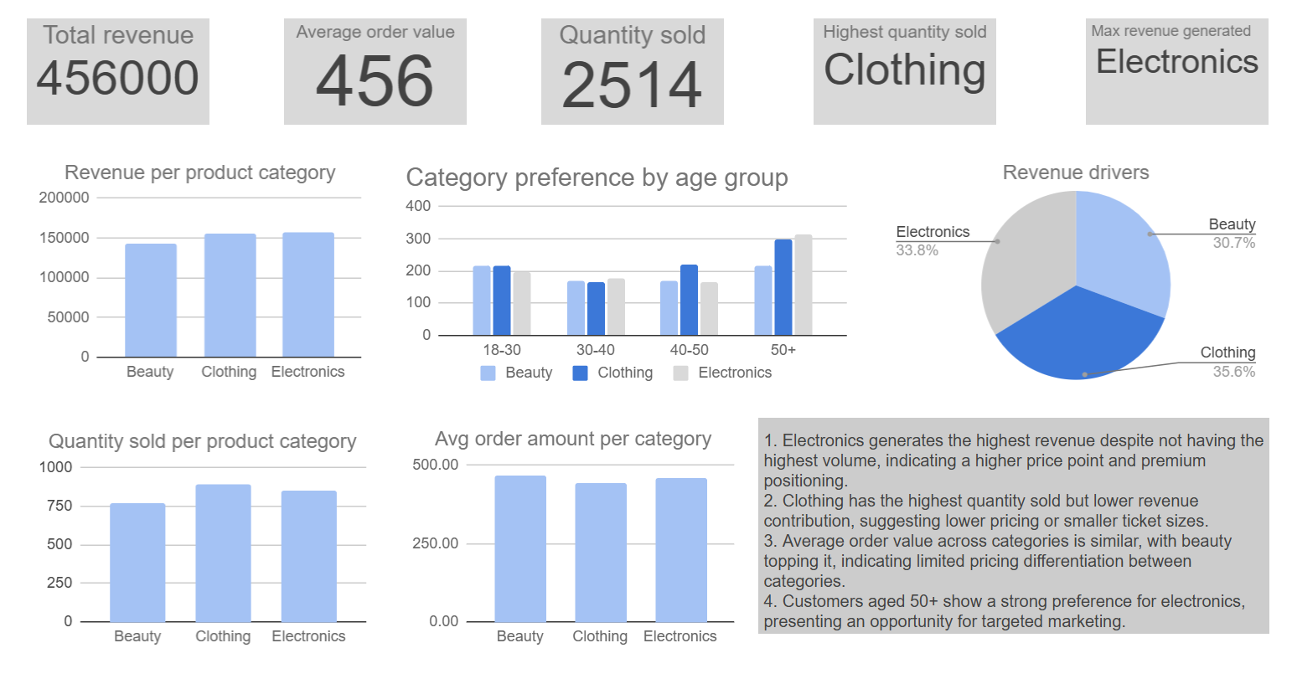
Product category dashboard

Slide 12
Product category insights
Electronics drives the highest revenue, reflecting premium pricing despite lower sales volume.
Clothing leads in quantity sold but contributes less revenue due to lower-priced purchases.
Average order value is fairly similar across categories, with Beauty slightly highest.
Customers aged 50+ strongly prefer Electronics, creating a clear targeting opportunity.

Slide 13
Product Category Recommendations
Prioritize Electronics with stronger marketing, premium promotions, and reliable stock availability.
Use Clothing to attract customers while increasing revenue through bundles and pricing optimization.
Grow Beauty through targeted promotions, pricing experiments, and product bundling.
Personalize category campaigns: Electronics for older customers, Clothing/Beauty for younger segments.
Increase order value through cross-selling, combo deals, and smart recommendations.
Optimize inventory by stocking high-demand items, focusing on high-margin products, and clearing slow-moving stock.
Build a balanced revenue mix by strengthening underperforming categories and reducing reliance on one category.

Slide 14
Business Summary
Revenue reached 456,000 with an average order value of 456, and 2,514 units sold.
Electronics is the top revenue category, while Clothing leads in sales volume.
Customers aged 50+ contribute the highest overall revenue.
Average order value is similar across categories, showing consistent pricing.
Focus on Electronics for growth, improve Clothing monetization, and target high-value 50+ customers with personalized marketing.

Slide 15


